Slide 1
C4.5

Slide 2
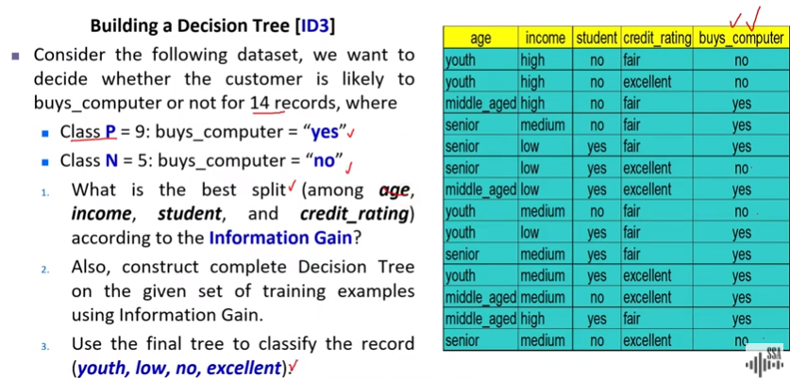
ID3

Slide 3
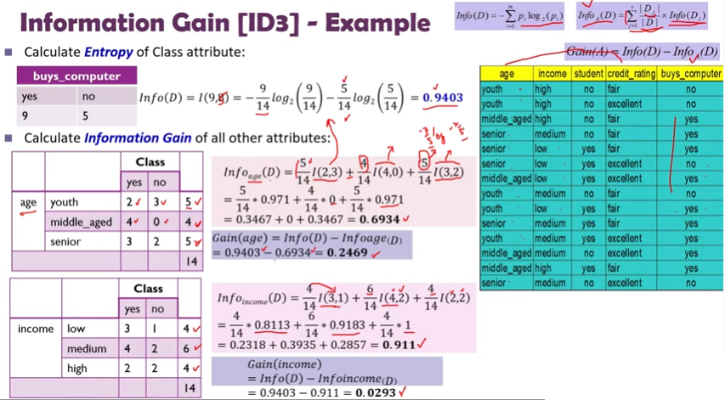

Slide 4
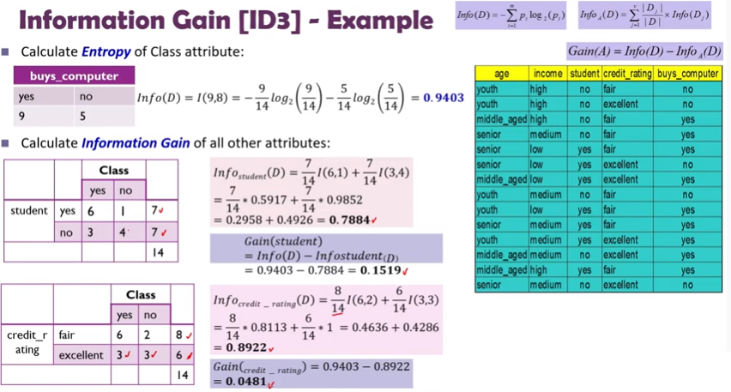

Slide 5
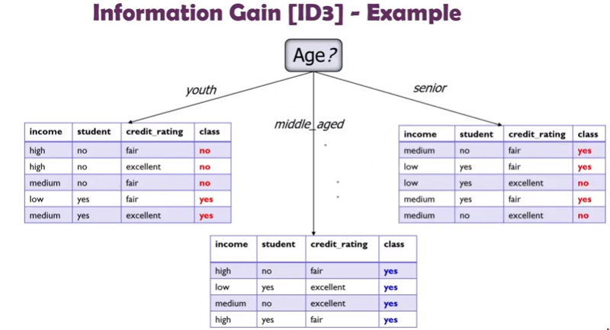

Slide 6
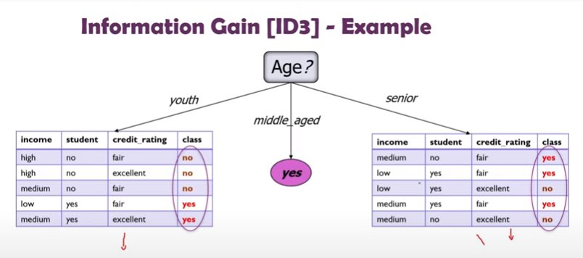

Slide 7
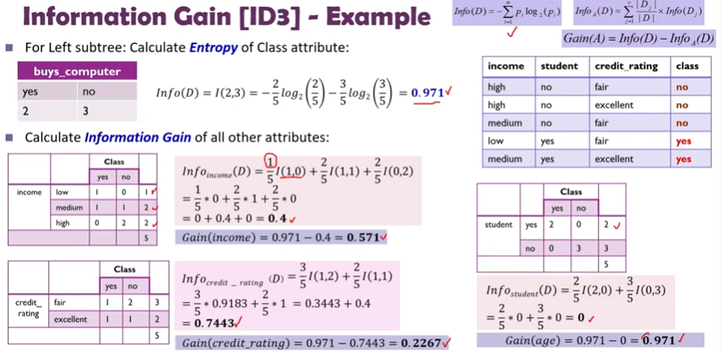

Slide 9
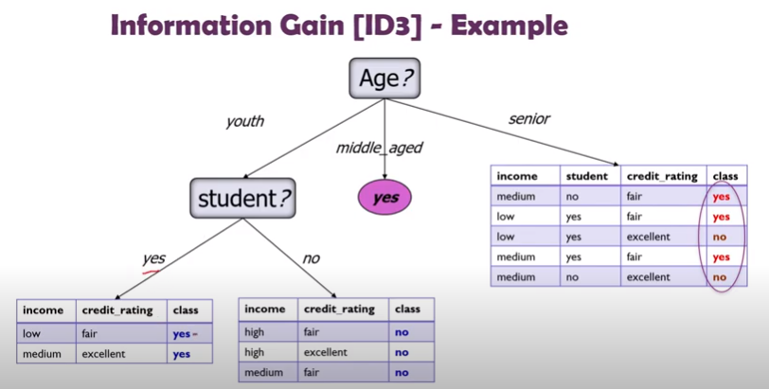

Slide 10
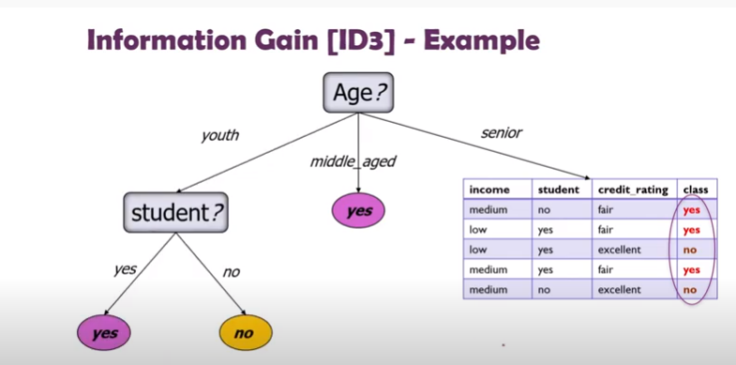

Slide 11
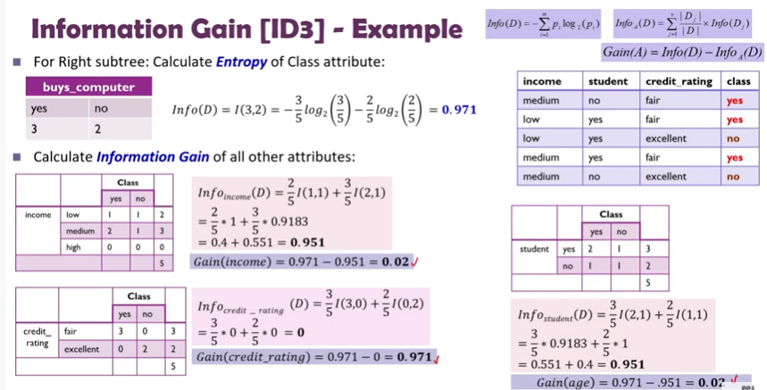

Slide 12
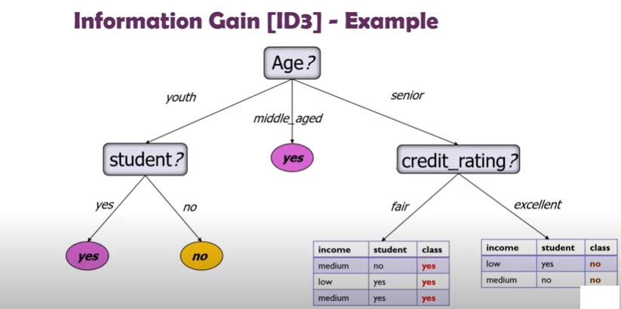

Slide 13
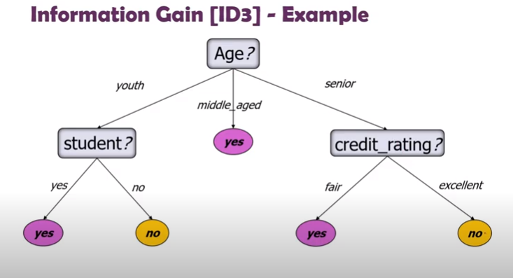

Slide 14
C4.5
Decision trees are still hot topics nowadays in data science world.
ID3 is the most common conventional decision tree algorithm but it has bottlenecks.
Attributes must be nominal values, dataset must not include missing data, and finally the algorithm tend to fall into overfitting.
Ross Quinlan, inventor of ID3, made some improvements for these bottlenecks and created a new algorithm named C4.5.
The algorithm can create a more generalized models including continuous data and could handle missing data.

Slide 15
Objective
Decision rules will be found based on entropy and information gain ratio pair of each feature.
In each level of decision tree, the feature having the maximum gain ratio will be the decision rule.

Slide 16
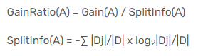
Contd…
In ID3 algorithm, we’ve calculated gains for each attribute. Here, we need to calculate gain ratios instead of gains.

Slide 17
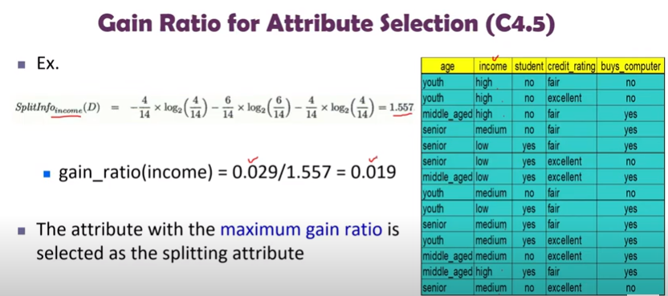

Slide 18
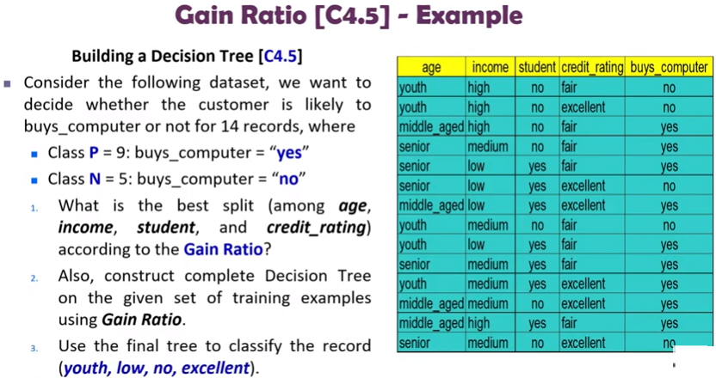

Slide 19
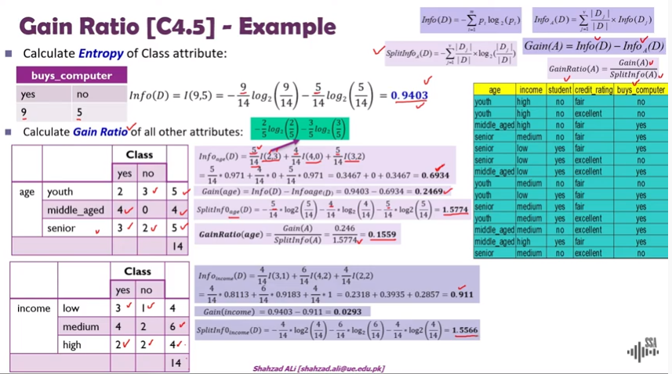

Slide 20
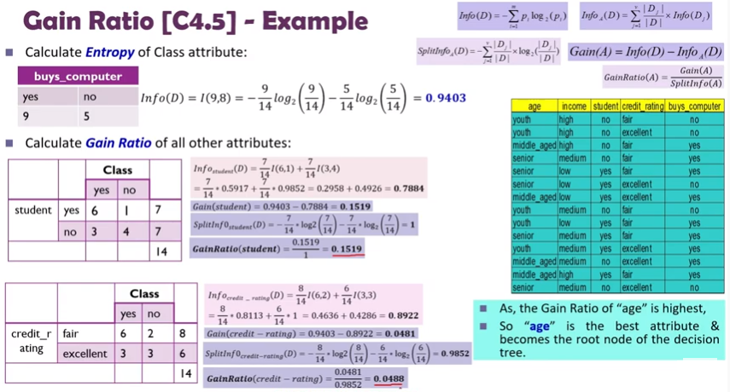

Slide 21
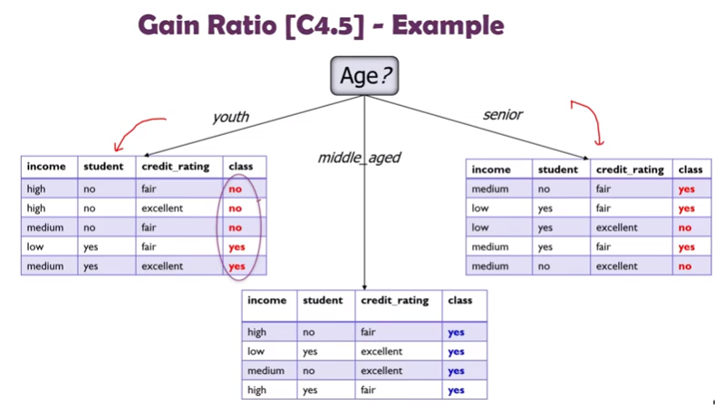

Slide 22
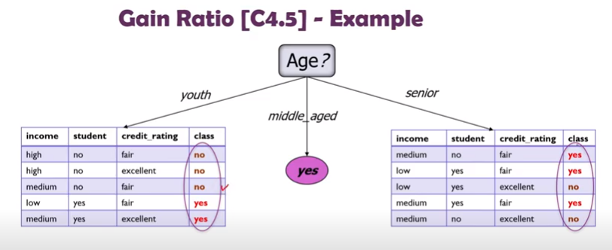

Slide 23
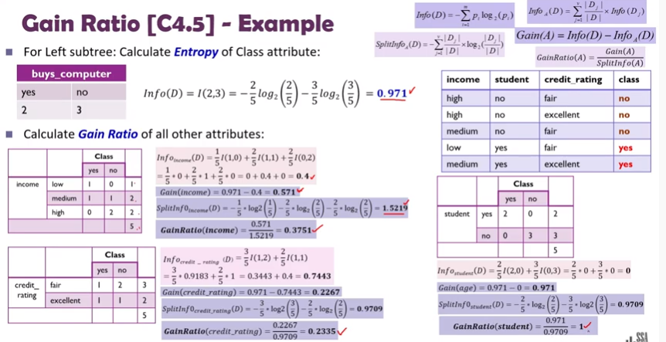

Slide 24
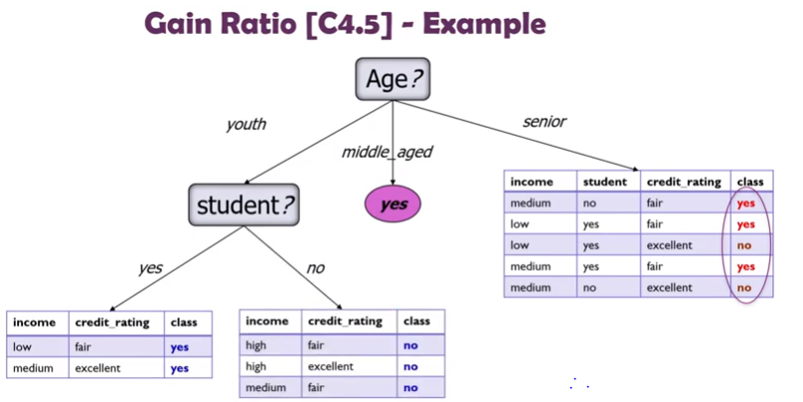

Slide 25
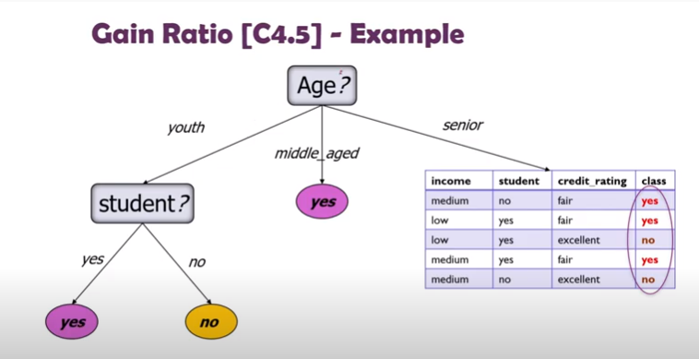

Slide 26
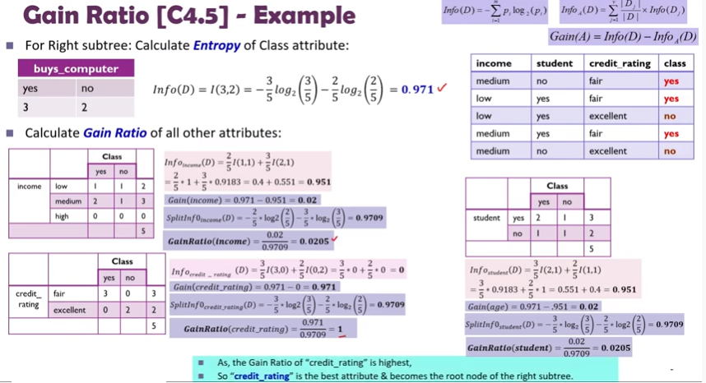

Slide 27
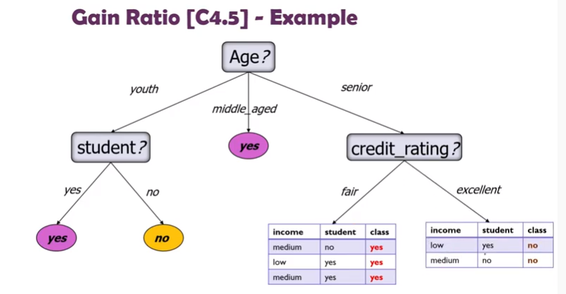

Slide 28
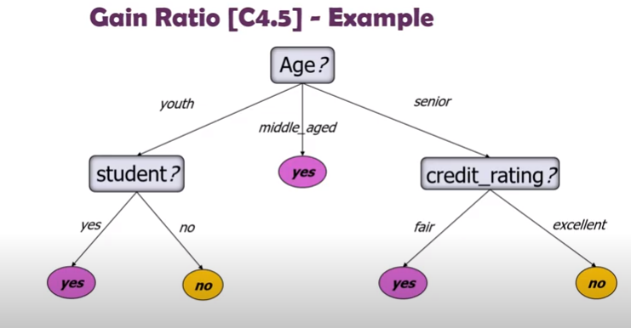

Slide 29
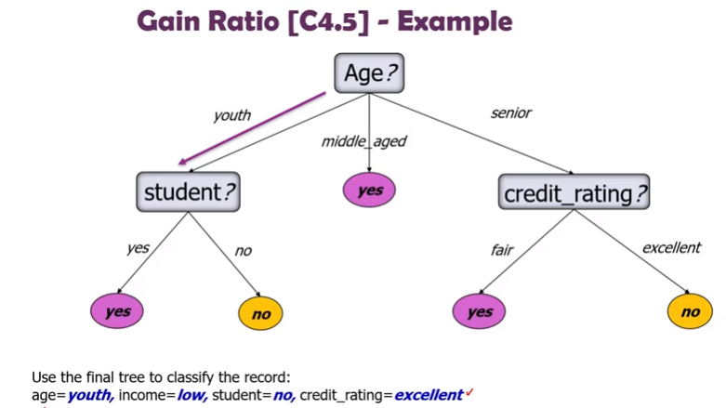

Slide 30
End

Slide 31
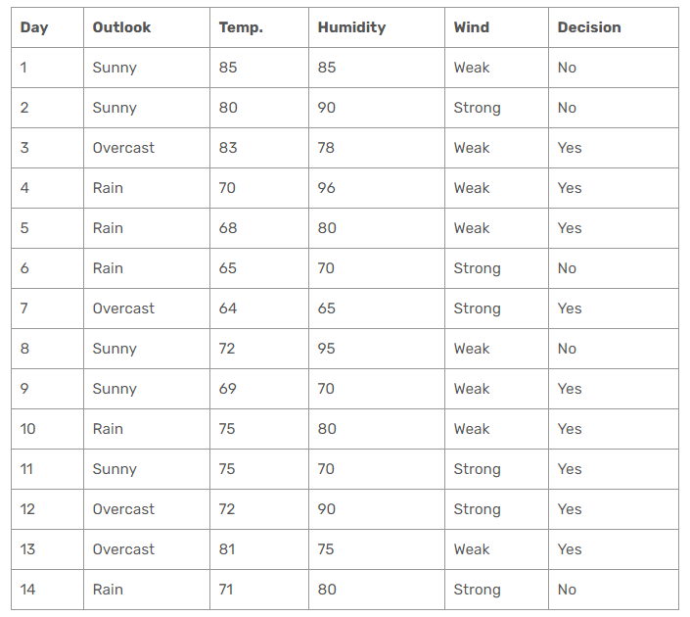

Slide 32
Contd…
Firstly, we need to calculate global entropy. There are 14 examples; 9 instances refer to yes decision, and 5 instances refer to no decision.
In ID3 algorithm, we’ve calculated gains for each attribute. Here, we need to calculate gain ratios instead of gains.

Slide 33
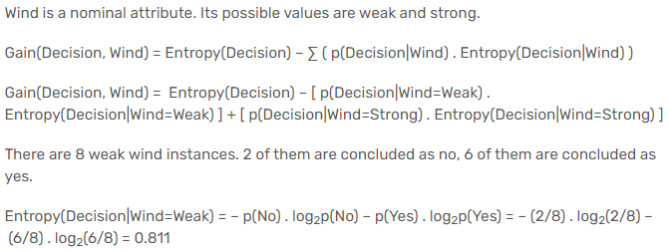
Wind Attribute

Slide 34
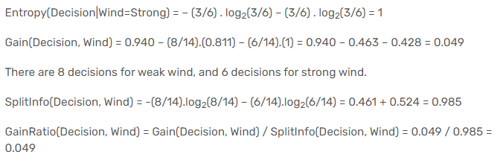
Contd…

Slide 35
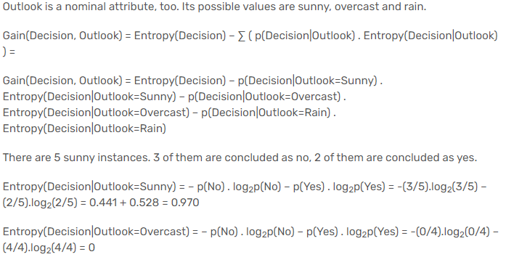
Outlook Attribute

Slide 36
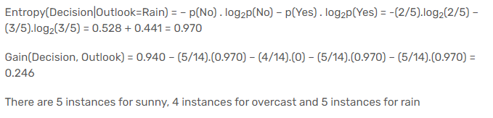
Contd…

Slide 37
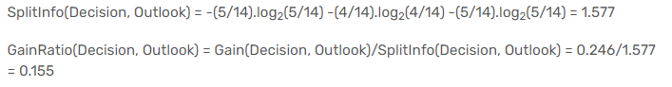
Contd…

Slide 38
Humidity Attribute
Humidity is a continuous attribute.
Need to convert continuous values to nominal ones.
C4.5 proposes to perform binary split based on a threshold value.
Threshold should be a value which offers maximum gain for that attribute.
Humidity attribute.
Sort the humidity values smallest to largest.

Slide 39
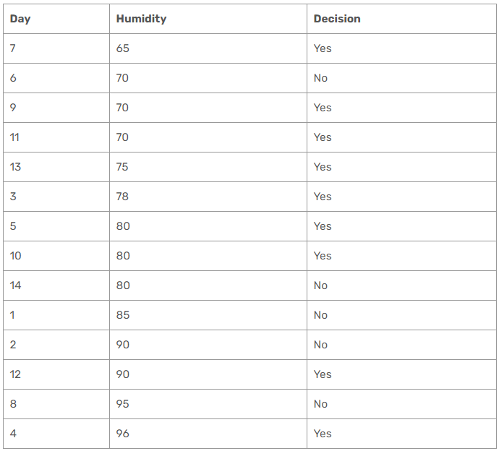

Slide 40
Contd…
Iterate on all humidity values and separate dataset into two parts as instances less than or equal to current value, and instances greater than the current value.
Calculate the gain and gain ratio for every step.
The value which maximizes the gain would be the threshold.

Slide 41
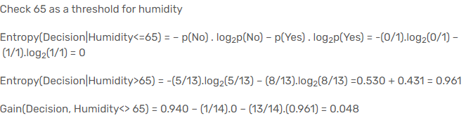
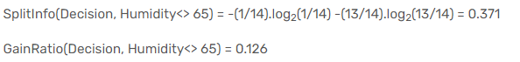
Contd…

Slide 42
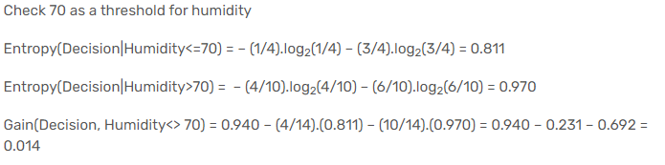
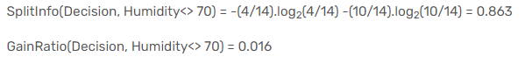
Contd…

Slide 43
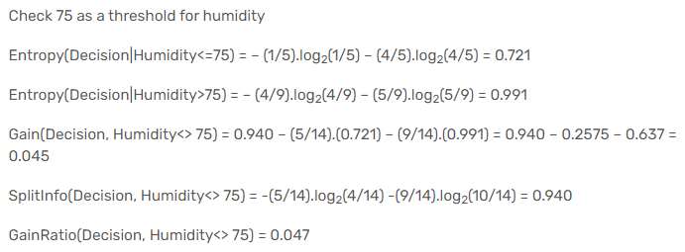
Contd…

Slide 44
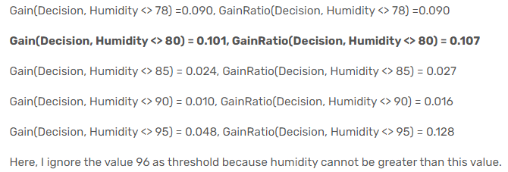
Contd…

Slide 45
Contd…
Gain maximizes when threshold is equal to 80 for humidity. This means that we need to compare other nominal attributes and comparison of humidity to 80 to create a branch in our tree.

Slide 46
Temperature Attribute
Temperature feature is continuous as well. When I apply binary split to temperature for all possible split points, the following decision rule maximizes for both gain and gain ratio.
Gain(Decision, Temperature <> 83) = 0.113, GainRatio(Decision, Temperature<> 83) = 0.305

Slide 47
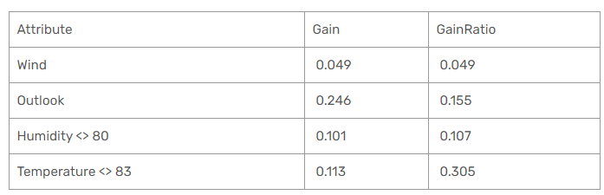
Node Selection

Slide 48
Summary
C4.5 algorithm solves most of problems in ID3.
The algorithm uses gain ratios instead of gains.
It creates more generalized trees and not to fall into overfitting.
The algorithm transforms continuous attributes to nominal ones based on gain maximization and in this way it can handle continuous data
Additionally, it can ignore instances including missing data and handle missing dataset.

Slide 49
Credits
https://www.youtube.com/channel/UCd4q5ZqV-fR1RU3SzaK4Sog/playlists

